Slide 1
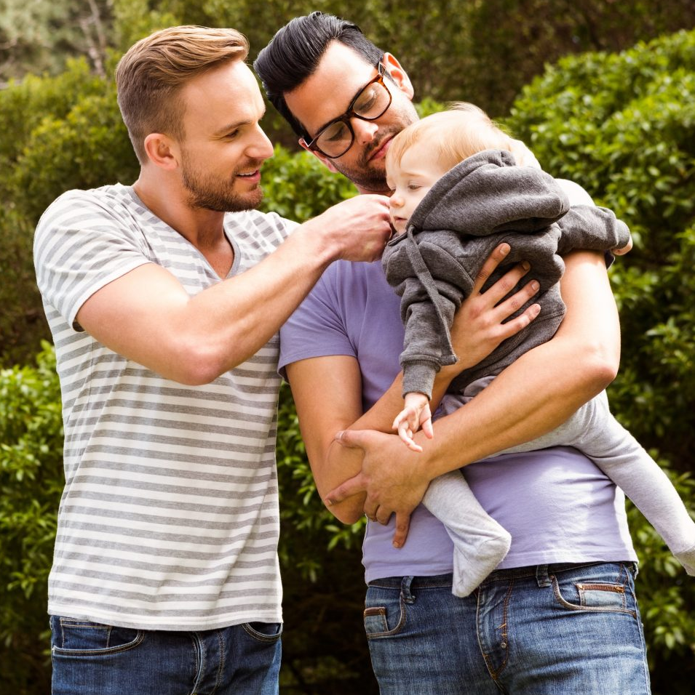
Did you know…?
SurrogacyUK have a Known Egg Donation pathway, that is now very similar to the surrogacy pathway. This means you’ll be able to build an ongoing friendship with your donor.
Egg donation through a clinic isn’t actually anonymous in the UK. Children born through egg donation can apply to the HFEA for non identifying information about their donor, and any half siblings, once they’re 16. At 18, they can apply for identifying information.
You can be a Known Egg Donor if you’re over 35. Clinics can have more flexibility for known donation.
SurrogacyUK provide an AMH test for potential donors, as part of the application process.
Known Egg Donation provides the opportunity for a ‘Mega Team’, where the child can know both their egg donor and surrogate. We have many successful Mega Teams at SurrogacyUK.
We have an open group on the Hub, where you can chat with others about Known Egg Donation Members – Known Egg Donation – Surrogacy UK member only HUB (suk-member-hub.co.uk)

Slide 2
Known Egg Donation pathway at SurrogacyUK
Application Process for Potential KEDs:
How to become a KED - Known Egg Donation - Surrogacy UK member only HUB
For Intended Parents:
Write a KED specific profile, using the template provided, and ask for it to be added to KED profiles.
The Call: When a KED decides to offer to get to know IPs. This must come from SUK.​
​
GTK: as with surrogacy, is a minimum of 3 months. ​
​
Agreement: mediated by a KED advisor. Must be completed before you start treatment.
​
Treatment: you move forward to create embryos together.​
Much more information about KED is available on the Hub here:
Known Egg Donation – Surrogacy UK member only HUB (suk-member-hub.co.uk)

Slide 3
Upcoming events
Online Known Egg Donor Chat
Thursday 14th September 8pm
Join Jemma, Rena & Vicky for a chat all about Known Egg Donation!
This social is open to anyone who has any interest in being a Known Egg Donor – whether you’ve been a KED in the past, you’re currently a KED, or possibly considering becoming a KED in the future.
Book here
Ask Us Anything About Known Egg Donation
Tuesday 3rd October 8pm
This session is open to anyone who has any interest Known Egg Donation – whether you’re an egg donor or intended parent. We would love it for those who have been through the KED process to join us and talk about their experiences too.
You’ll have the chance to ask any questions you may have – these can be sent anonymously, in advance. Various members of the SUK team will be there to talk all about KED at SurrogacyUK.
Book here

